Slide 1
Study Benefits
for
Outsourced Service Workers
January 2016

Slide 2
WHO CAN APPLY?
Outsourced Service Workers who
work for an “outsourced service company” contracted to NMMU, as identified by NMMU Management.
is permanently based on one or more NMMU campus.
is a permanent employee, or have a contract which exceeds one (1) year where employment is on a salary basis of more than twenty fours (24) hours per month.
Is contracted for one (1) year or less, where employment is on a salary basis of more than twenty fours (24) hours per month, will qualify if the employee’s immediate previous period of service and the new employment term together add up to at least five (5) years.

Slide 3
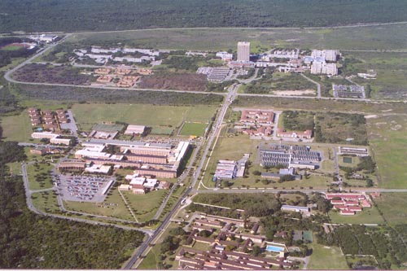
BENEFITS
When studying at NMMU:
A 100% discount will be provided on tuition fees and application fees for formal (government-subsidized) studies at NMMU.
All other fees, including but not limited to, books, enrolment fees, residence fees, exemption fees, sport clubs’ fees, cultural societies fees, as well as related travel and subsistence costs, are excluded.
2. The benefit is extended to the immediate family of qualifying employees (spouse / dependent children).

Slide 4
SPOUSE / DEPENDENT CHILDREN
SPOUSE
A spouse is the person to whom the employee is married in terms of any South African law.
DEPENDENT CHILD
is the employee’s biological child or legally adopted child or where an employee has been appointed as the child’s legal guardian by a court of law.
is normally not over the age of thirty (30); and
is not in receipt of a regular remuneration which is more than the amount determined by MANCO from time to time

Slide 5
BENEFIT TO STUDY AT ANOTHER UNIV.
ONLY APPLIES TO THE EMPLOYEE
You can study at any public university in SA
Benefit to study at a school for a Grade 12 / Matric / ABET
Government night school
Requires application

Slide 6
RULES IN APPLYING THE BENEFIT
Benefits are only applicable for full calendar months of employment.
Should the employee leave the employment of the company for whatever reason, the benefit will be provided pro-rata
New appointments who qualify will be eligible for the benefit pro-rata from the date of appointment.
Note these rules also apply where a family member is the recipient of the benefit through the employee.
The benefit to study at NMMU is applicable to:
the first and second enrolment per module only.
Change in study direction allowed once only.

Slide 7
GENERAL
The provision of this benefit does not guarantee acceptance into a study programme of the University.
The employee will be liable for tax payable for this benefit, as determined by the South African Revenue Services.
The University retains the right to withdraw or amend this benefit at any time after due process and with due reason.

Slide 8
HOW TO APPLY
Complete the prescribed application form.
Available from NMMU Human Resources Department
(041-5043555)
2. Collect all required proof.
Certified copy of ID
Letter from employer
Proof of relation (spouse / dependent)
Send the completed form and proof to NMMU HR Dept.
Human Resources Development
Office 19c,
Block L,
HR Offices,
North Campus.

Slide 9
The End

